Slide 1
Chapter 6:
Programming The Basic Computer
Subject: Computer Organization

Slide 2
Introduction
A computer system includes both hardware and software. The designer should be familiar with both of them.
This chapter introduces some basic programming concepts and shows their relation to the hardware representation of instructions.
A program may be : dependent or independent on the computer that runs it.

Slide 3
Instruction Set of the Basic Computer
  Symbol Hex code Description
  AND 0 or 8 AND M to AC
  ADD 1 or 9 Add M to AC, carry to E
  LDA 2 or A Load AC from M
  STA 3 or B Store AC in M
  BUN 4 or C Branch unconditionally to m
  BSA 5 or D Save return address in m and branch to m+1
  ISZ 6 or E Increment M and skip if zero
  CLA 7800 Clear AC
  CLE 7400 Clear E
  CMA 7200 Complement AC
  CME 7100 Complement E
  CIR 7080 Circulate right E and AC
  CIL 7040 Circulate left E and AC
  INC 7020 Increment AC, carry to E
  SPA 7010 Skip if AC is positive
  SNA 7008 Skip if AC is negative
  SZA 7004 Skip if AC is zero
  SZE 7002 Skip if E is zero
  HLT 7001 Halt computer
  INP F800 Input information and clear flag
  OUT F400 Output information and clear flag
  SKI F200 Skip if input flag is on
  SKO F100 Skip if output flag is on
  ION F080 Turn interrupt on
  IOF F040 Turn interrupt off
cpe 252: Computer Organization

Slide 4
Machine Language
Program: A list of instructions that direct the computer to perform a data processing task.
Many programming languages (C++, JAVA). However, the computer executes programs when they are represented internally in binary form.
Binary code: a binary representation of instructions and operands as they appear in computer memory.
Octal or hexadecimal code: translation of binary code to octal or hexadecimal representation.
cpe 252: Computer Organization

Slide 5
Hierarchy of programming languages
Machine Language
Assembly Language
High-level programming language
Assembly language:
- The user uses symbols (Letter, numerals, or special characters) for the operation, address and other parts of the instruction code (Symbolic code).
- symbolic code → binary coded instruction
- concerned with the computer hardware behavior.
- The translation is done by a special program called an assembler

Slide 6
Binary/Hex Code
Binary Program to Add Two Numbers:
Location Instruction Code
Location Instruction
0 0010 0000 0000 0100
1 0001 0000 0000 0101
10 0011 0000 0000 0110
11 0111 0000 0000 0001
100 0000 0000 0101 0011
101 1111 1111 1110 1001
110 0000 0000 0000 0000
Binary code
000 2004
001 1005
002 3006
003 7001
004 0053
005 FFE9
006 0000
Hexadecimal code
It is hard to understand the task of the program
➔ symbolic code

Slide 7
Symbolic OP-Code for addition
Location Instruction Comments
000 LDA 004 Load 1st operand into AC
001 ADD 005 Add 2nd operand to AC
002 STA 006 Store sum in location 006
003 HLT Halt computer
004 0053 1st operand
005 FFE9 2nd operand (negative)
006 0000 Store sum here
Symbolic names of instructions instead of binary or hexadecimal code.
The address part of memory-reference and operands ➔ remain hexadecimal.
Symbolic programs are easier to handle.

Slide 8
Assembly-Language Program
  ORG 0 /Origin of program is location 0 0 LDA A /Load operand from location A
  1 ADD B /Add operand from location B 2 STA C /Store sum in location C
  3 HLT /Halt computer
  A, DEC 83 /Decimal operand
  B, DEC -23 /Decimal operand
  6 C, DEC 0 /Sum stored in location C
  7 END /End of symbolic program

Slide 9
Assembly-Language Program
A further step is to replace:
hexadecimal address → symbolic address, hexadecimal operand → decimal operand.
If the operands are placed in memory following the instructions, and if the length of the program is not known in advance, the numerical location of operands is not known until the end of program is reached.
Decimal numbers are more familiar than hex. equivalents.

Slide 10
Assembly Language
Following the rules of the language → the programs will be translated correctly.
Almost every commercial computer has its own particular assembly language.

Slide 11
Rules of the Language
Each line of an assembly language program is arranged in three columns called fields:
  1- The Label field: May be empty or specify a
  symbolic address.
  2- The Instruction field: Specifies a machine instruction or pseudo instruction.
  3- The Comment field: May be empty or it may include a comment.
  Example:
  ORG Lab
  Lab, ADD op1 / this is an add operation.
  Label Instruction comment
  Note that Lab is a symbolic address.

Slide 12
Cont’
1-Symbolic address: Consists of one, two, or three (maximum) alphanumeric characters.
The first character must be a letter, the next two may be letters or numerals.
A symbolic address in the label field is terminated by a comma so that it will be recognized as a label by the assembler.
Examples: Which of the following is a valid symbolic address: r2 : Yes; Sum5: No
tmp : Yes.

Slide 13
Instruction field
The instruction field contains:
1- Memory-Reference Instruction (MRI)
2- A register-reference or I/O instruction (non-MRI)
3- A pseudo instruction with or without an operand. Ex: ORG, END, DEC, HEX

Slide 14
1-Memory-Reference Inst.
Occupies two or three symbols separated by spaces.
The first must be a three-letter symbol defining an MRI operation code. (ADD)
The second is a symbolic address.
Ex: ADD OPR direct address MRI
The third (optional)-Letter I to denote an indirect address instruction
Ex: ADD OPR I Indirect address MRI

Slide 15
Memory-Reference Inst. / cont.
A symbolic address in the instruction field specifies the memory location of the operand.
This location MUST be defined somewhere in the program by appearing again as a label in the first column. Ex: LDA X1
X1, HEX 40
2-Non-Memory-Reference Inst.
Does not have an address part.
It is recognized in the instruction field by one of the three-letter symbols (CLA, INC, CLE,INP, OUT,..).

Slide 16
Pseudo instruction
Not a machine instruction
It is an instruction to the assembler giving information about some phase of the translation
  Ex:
  ORG N
  Hexadecimal number N is the memory loc. for the instruction or
  operand listed in the following line
  END
  Denotes the end of symbolic program
  DEC N
  Signed decimal number N to be converted to binary
  HEX N
  Hexadecimal number N to be converted to binary

Slide 17
Comment Field
A line of code may or may not have a comment. (Ex: STA A0 / storing at A0)
A comment must be preceded by a slash for the assembler to recognize the beginning of the comment field.

Slide 18
Example:
An assembly language program to subtract two numbers
Memory Add.
100
101
102
103
104
105
106
107
108
109
ORG 100
LDA SUB
CMA
INC
ADD MIN
STA DIF
HLT
DEC 83
DEC -23
HEX 0
END
Instruction
/ Origin of program is location 100
/ Load subtrahend to AC
/ Complement AC
/ Increment AC
/ Add minuend to AC
/ Store difference
/ Halt computer
/ Minuend
/ Subtrahend
/ Difference stored here
/ End of symbolic program
comment
MIN,
SUB,
DIF,
Label

Slide 19
TRANSLATION TO BINARY
Hexadecimal Code
Symbolic Program
Location Content
100 2107
101 7200
102 7020
103 1106
104 3108
105 7001
106 0053
107 FFE9
108 0000
MIN,
SUB,
DIF,
ORG 100
LDA SUB
CMA
INC
ADD MIN
STA DIF
HLT
DEC 83
DEC -23
HEX 0
END

Slide 20
Address Symbol Table
The translation process can be simplified if we scan the entire symbolic program twice.
No translation is done during the first scan. We just assign a memory location to each instruction and operand.
Such assignment defines the address value of labels and facilitates the translation during the second scan.

Slide 21
ORG & END are not assigned a numerical location because they do not represent an instruction or operand.
Address symbol Hex Address
MIN 106
SUB 107
DIF 108

Slide 22
Example
LDA SUB
Address mode: direct → I=0
Instruction: LDA → 010
Address : SUB → 107
Instruction 0 010 107 → 2107

Slide 23
The Assembler
An Assembler is a program that accepts a symbolic language and produces its binary machine language equivalent.
The input symbolic program :Source program.
The resulting binary program: Object program.
Prior to assembly, the program must be stored in the memory.
A line of code is stored in consecutive memory locations with two characters in each location. (each character 8 bits)→ memory word 16 bits

Slide 24
Example: storing the symbolic program in Memory
PL3, LDA SUB I
By referring to the ASCII code table, we get:
Memory word | Symbol | Hex code
1 | P L | 50 4C
2 | 3 , | 33 2C
3 | L D | 4C 44
4 | A | 41 20
5 | S U | 53 55
6 | B | 42 20
7 | I CR | 49 0D

Slide 25
First Pass
The assembler scans the symbolic program twice.
First pass: generates an “Address Symbol Table” that connects all user-defined address symbols with their binary equivalent value.
Second Pass: Binary translation

Slide 26
First Pass /cont.
To keep track of instruction locations: the assembler uses a memory word called a location counter (LC).
LC stores the value of the memory location assigned to the instruction or operand presently being processed.
LC is initialized to the first location using the ORG pseudo instruction. If there is no ORG→ LC = 0.

Slide 27
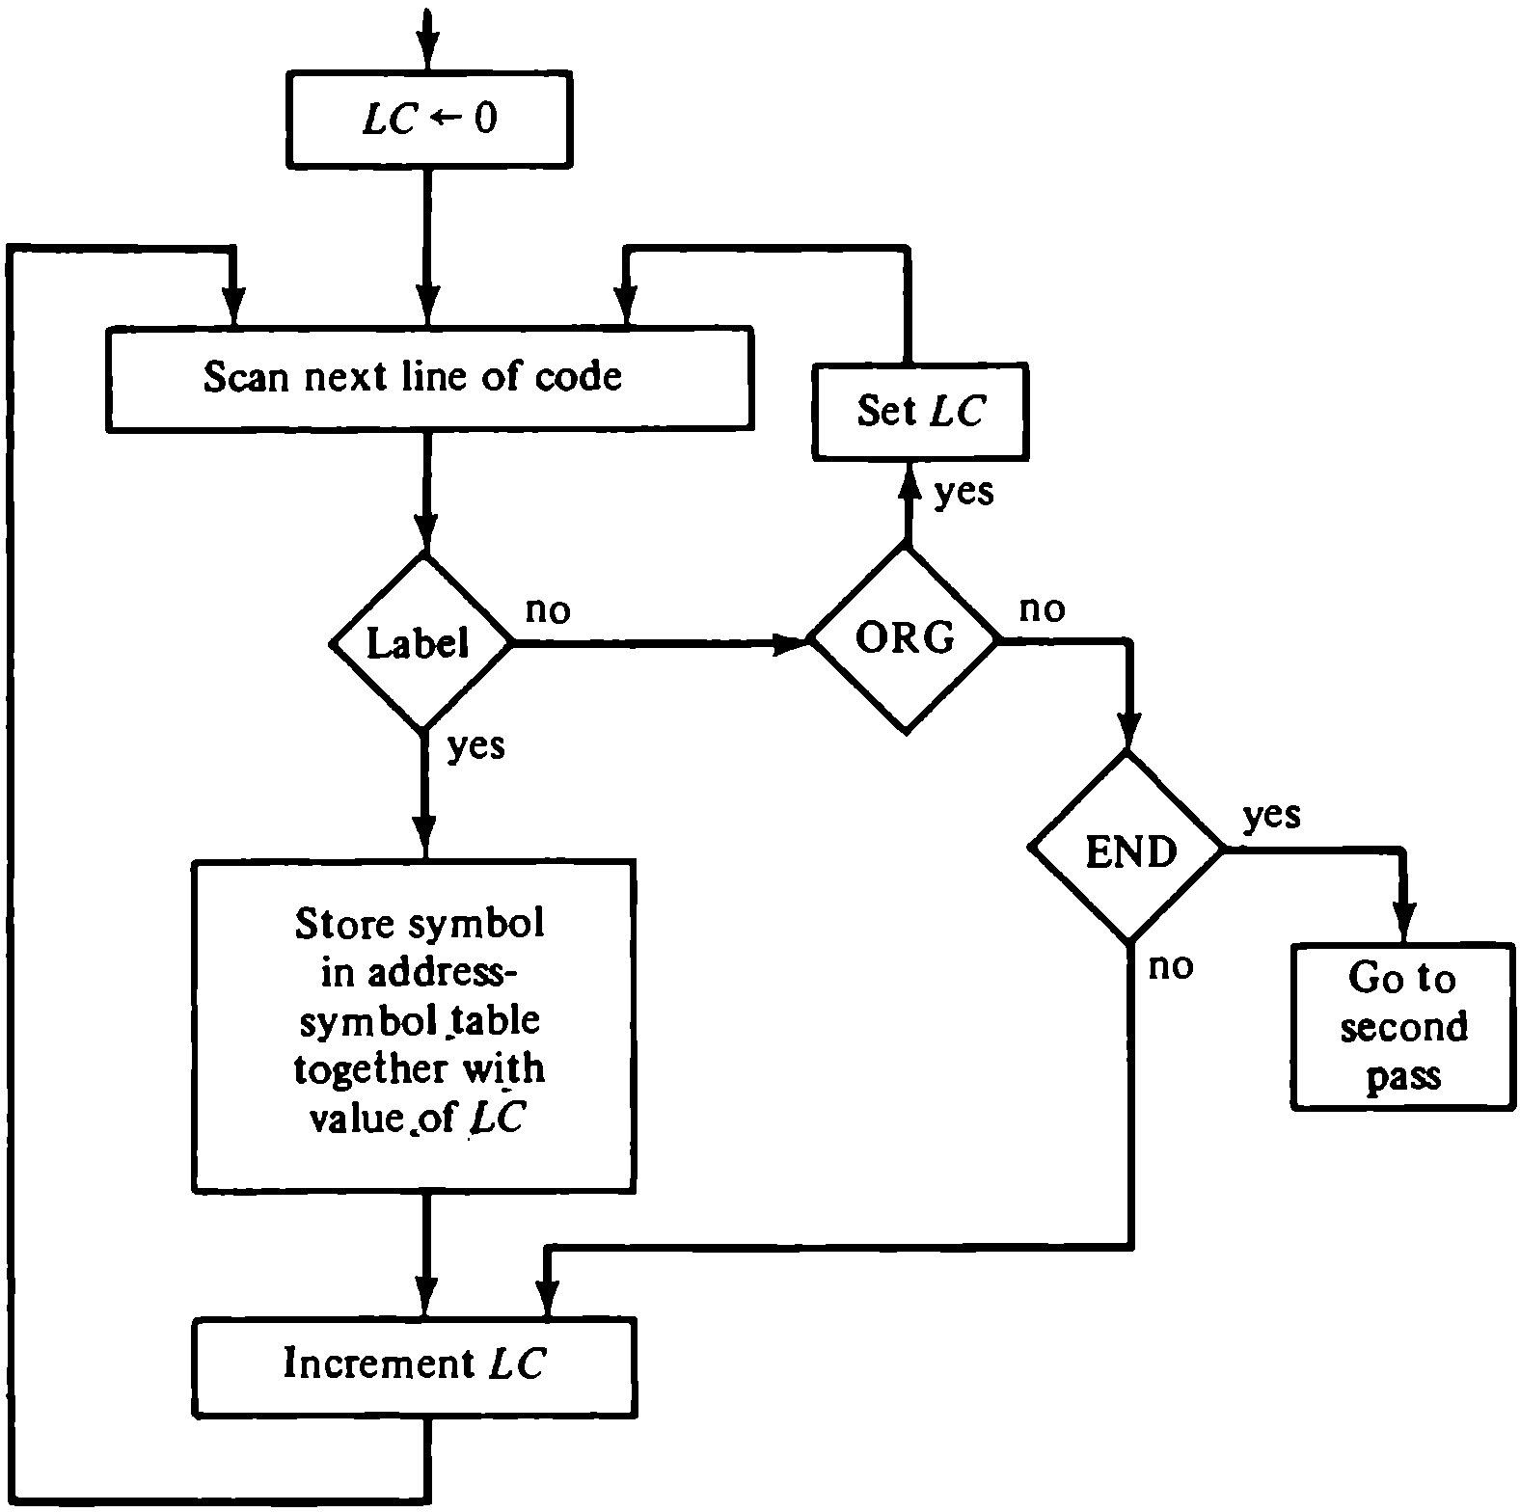
First Pass/ cont.

Slide 28
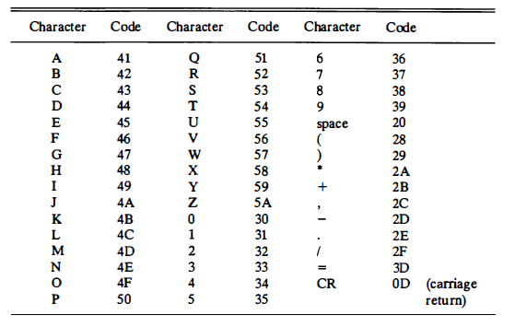
Hexadecimal Character code

Slide 29
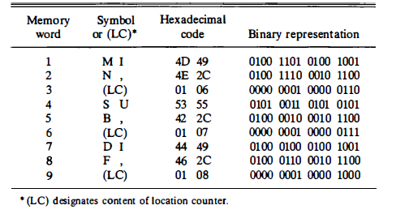
Add. Symbol Table for addition program

Slide 30
Second Pass
Machine instructions are translated in this pass by means of a table lookup procedure.
A search of table entries is performed to determine whether a specific item matches one of the items stored in the table.

Slide 31
Assembler Tables
Four tables are used:
  1) Pseudoinstruction table. (ORG, DEC, HEX, END)
  2) MRI table. (7 symbols for memory reference and
  3-bit opcode equivalent)
  3) Non-MRI table. (18 Reg. & I/O instruction and
  16-bit binary code equivalent)
  4) Address symbol table. (Generated during first pass)

Slide 32
Second Pass/ cont.
Second pass
LC <- 0
Scan next line of code
Done
Set LC
yes
yes
Pseudo
yes
ORG
no
END
instr.
no
no
DEC or
yes
MRI
no
HEX
Convert
Get operation code
operand
and set bits 2-4
Valid
no
to binary
non-MRI
and store
instr.
in location
Search address-
given by LC
symbol table for
yes
binary equivalent
of symbol address
and set bits 5-16
Store binary
Error in
yes
equivalent of
line of
I
no
instruction
code
in location
given by LC
Set
Set
first
first
bit to 1
bit to 0
Assemble all parts of
Increment LC
binary instruction and
store in location given by LC

Slide 33
Error Diagnostics
One important task of the assembler is to check for possible errors in the symbolic program.
Example:
  Invalid machine code symbol.
  A symbolic address that did not appear as
  a label.

Slide 34
Program Loops
A sequence of instructions that are executed many times, each time with a different set of data
Fortran program to add 100 numbers:
DIMENSION A(100)
INTEGER SUM, A
SUM = 0
DO 3 J = 1, 100
3 SUM = SUM + A(J)

Slide 35
Program Loops/ cont.
LOP,
ADS,
PTR,
NBR,
CTR,
SUM,
ORG 100
LDA ADS
STA PTR
LDA NBR
STA CTR
CLA
ADD PTR I
ISZ PTR
ISZ CTR
BUN LOP
STA SUM
HLT
HEX 150
HEX 0
DEC -100
HEX 0
HEX 0
ORG 150
DEC 75
.
.
DEC 23
END
/ Origin of program is HEX 100
/ Load first address of operand
/ Store in pointer
/ Load -100
/ Store in counter
/ Clear AC
/ Add an operand to AC
/ Increment pointer
/ Increment counter
/ Repeat loop again
/ Store sum
/ Halt
/ First address of operands
/ Reserved for a pointer
/ Initial value for a counter
/ Reserved for a counter
/ Sum is stored here
/ Origin of operands is HEX 150
/ First operand
/ Last operand
/ End of symbolic program

Slide 36
Programming Arithmetic & Logic Operations
Software Implementation
- Implementation of an operation with a program using machine instruction set
- Usually used: when the operation is not included in the instruction set
Hardware Implementation
- Implementation of an operation in a computer with one machine instruction

Slide 37
Multiplication
We will develop a program to multiply two numbers.
Assume positive numbers and neglect the sign bit for simplicity.
Also, assume that the two numbers have no more than 8 significant bits → 16-bit product.

Slide 38
Multiplication / cont.
Example with four significant digits
P
X =
Y =
0000 1111
0000 1011 0000 0000
0000 1111 0000 1111
0001 1110 0010 1101
0000 0000 0010 1101
0111 1000 1010 0101
1010 0101
X holds the multiplicand
Y holds the multiplier
P holds the product

Slide 39
CTR ← - 8
P ← 0
Example with four significant digits
E ← 0
X =
Y =
P
AC ← Y
0000 1111
0000 1011 0000 0000
0000 1111 0000 1111
0001 1110 0010 1101
0000 0000 0010 1101
0111 1000 1010 0101
1010 0101
X holds the multiplicand
Y holds the multiplier
P holds the product
cir EAC
Y ← AC
=0
E
=1
P ← P + X
E ← 0
AC ← X
cil EAC
cil
X ← AC
CTR ← CTR + 1
≠ 0
CTR
=0
Stop

Slide 40
LOP,
ONE,
ZRO,
CTR,
X,
Y,
P,
ORG 100
CLE
LDA Y
CIR
STA Y
SZE
BUN ONE
BUN ZRO
LDA X
ADD P
STA P
CLE
LDA X
CIL
STA X
ISZ CTR
BUN LOP
HLT
DEC -8
HEX 000F
HEX 000B
HEX 0
END
/ Clear E
/ Load multiplier
/ Transfer multiplier bit to E
/ Store shifted multiplier
/ Check if bit is zero
/ Bit is one; goto ONE
/ Bit is zero; goto ZRO
/ Load multiplicand
/ Add to partial product
/ Store partial product
/ Clear E
/ Load multiplicand
/ Shift left
/ Store shifted multiplicand
/ Increment counter
/ Counter not zero; repeat loop
/ Counter is zero; halt
/ This location serves as a counter
/ Multiplicand stored here
/ Multiplier stored here
/ Product formed here

Slide 41
Double Precision Addition
When two 16-bit unsigned numbers are multiplied, the result is a 32-bit product that must be stored in two memory words.
A number stored in two memory words is said to have double precision.
When a partial product is computed, it is necessary to add a double-precision number to the shifted multiplicand, which is also double-precision.
This provides better accuracy

Slide 42
Double Precision Addition / cont.
One of the double precision numbers is stored in two consecutive memory locations, AL & AH. The other number is placed in BL & BH.
The two low-order portions are added and the carry is transferred to E. The AC is cleared and E is circulated into the LSB of AC.
The two high-order portions are added and the sum is stored in CL & CH.

Slide 43
Double Precision Addition / cont.
LDA AL
ADD BL
STA CL
CLA
CIL
ADD AH
ADD BH
STA CH
HLT
AL, _____
AH, _____
BL, _____
BH, _____
CL, _____
CH, _____
/ Load A low
/ Add B low, carry in E
/ Store in C low
/ Clear AC
/ Circulate to bring carry into AC(16)
/ Add A high and carry
/ Add B high
/ Store in C high
/ Location of operands

Slide 44
Logic Operations
All 16 logic operations (table 4-6) can be implemented using the AND & complement operations.
Example: OR : x + y = (x’.y’)’ Demorgan’s
LDA A
CMA
STA TMP
LDA B
CMA
AND TMP
CMA
/ Load 1st operand
/ Complement to get A’
/ Store in a temporary location
/ Load 2nd operand B
/ Complement to get B’
/ AND with A’ to get A’ AND B’
/ Complement again to get A OR B

Slide 45
Shift Operations
The circular shift operations are machine instructions in the basic computer.
Logical and Arithmetic shifts can be programmed with a small number of instructions.

Slide 46
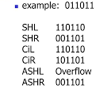

Logical Shift Operations
Logical shift right
CLE
CIR
Logical shift left
CLE
CIL

Slide 47
Arithmetic Shift Operations
Arithmetic shift right: it is necessary that the sign bit in the leftmost position remain unchanged. But the sign bit itself is shifted into the high-order bit position of the number.
CLE / Clear E to 0
SPA / Skip if AC is positive, E remains 0
CME / AC is negative, set E to 1
CIR / Circulate E and AC

Slide 48
Arithmetic Shift Operations /cont.
Arithmetic shift left: it is necessary that the added bit in the LSB be 0.
CLE
CIL
The sign bit must not change during this shift.
With a circulate instruction, the sign bit moves into E.

Slide 49
Arithmetic Shift Operations /cont.
The sign bit has to be compared with E after the operation to detect overflow.
If the two values are equal → No overflow.
If the two values are not equal → Overflow.

Slide 50
Subroutines
The same piece of code might be written again in many different parts of a program.
Write the common code only once.
Subroutines :A set of common instructions that can be used in a program many times
Each time a subroutine is used in the main program, a branch is made to the beginning of the subroutine. The branch can be made from any part of the main program.

Slide 51
Subroutines /cont.
After executing the subroutine, a branch is made back to the main program.
It is necessary to store the return address somewhere in the computer for the subroutine to know where to return.
In the basic computer, the link between the main program and a subroutine is the BSA instruction.

Slide 52
Subroutines example- (CIL 4 times)
Loc.
100
101
102
103
104
105
106
107
108
109
10A
10B
10C
10D
10E
10F
110
X,
Y,
SH4,
MSK,
ORG 100
LDA X
BSA SH4
STA X
LDA Y
BSA SH4
STA Y
HLT
HEX 1234
HEX 4321
HEX 0
CIL
CIL
CIL
CIL
AND MSK
BUN SH4 I
HEX FFF0
END
/ Main program
/ Load X
/ Branch to subroutine
/ Store shifted number
/ Load Y
/ Branch to subroutine again
/ Store shifted number
/ Subroutine to shift left 4 times
/ Store return address here
/ Circulate left once
/ Circulate left fourth time
/ Set AC(13-16) to zero
/ Return to main program
/ Mask operand
Notes:
Answer: 234 and 321

Slide 53
Subroutines /cont.
The first memory location of each subroutine serves as a link between the main program and the subroutine.
The procedure for branching to a subroutine and returning to the main program is referred to as a subroutine linkage.
The BSA instruction performs the call.
The BUN instruction performs the return.

Slide 54
Subroutine Parameters and Data Linkage
When a subroutine is called, the main program must transfer the data it wishes the subroutine to work with.
It is necessary for the subroutine to have access to data from the calling program and to return results to that program.
The accumulator can be used for a single input parameter and a single output parameter.

Slide 55
Subroutine Parameters and Data Linkage /cont.
In computers with multiple processor registers, more parameters can be transferred this way.
Another way to transfer data to a subroutine is through the memory.
Data are often placed in memory locations following the call.

Slide 56
Parameter Linkage
Example: OR : x + y = (x’.y’)’
Loc.
200
201
202
203
204
205
206
207
208
209
20A
20B
20C
20D
20E
20F
210
X,
Y,
OR,
TMP,
ORG 200
LDA X
BSA OR
HEX 3AF6
STA Y
HLT
HEX 7B95
HEX 0
HEX 0
CMA
STA TMP
LDA OR I
CMA
AND TMP
CMA
ISZ OR
BUN OR I
HEX 0
END
/ Load 1st operand into AC
/ Branch to subroutine OR
/ 2nd operand stored here
/ Subroutine returns here
/ 1st operand stored here
/ Result stored here
/ Subroutine OR
/ Complement 1st operand
/ Store in temporary location
/ Load 2nd operand
/ Complement 2nd operand
/ AND complemented 1st operand
/ Complement again to get OR
/ Increment return address
/ Return to main program
/ Temporary storage

Slide 57
Subroutine Parameters and Data Linkage /cont.
It is possible to have more than one operand following the BSA instruction.
The subroutine must increment the return address stored in its first location for each operand that it extracts from the calling program.

Slide 58
Data Transfer
If there is a large amount of data to be transferred, the data can be placed in a block of storage and the address of the first item in the block is then used as the linking parameter.
SUBROUTINE MVE (SOURCE, DEST, N)
DIMENSION SOURCE(N), DEST(N)
DO 20 I = 1, N
DEST(I) = SOURCE(I)
RETURN
END

Slide 59
Data transfer
MVE,
LOP,
PT1,
PT2,
CTR,
BSA MVE
HEX 100
HEX 200
DEC -16
HLT
HEX 0
LDA MVE I
STA PT1
ISZ MVE
LDA MVE I
STA PT2
ISZ MVE
LDA MVE I
STA CTR
ISZ MVE
LDA PT1 I
STA PT2 I
ISZ PT1
ISZ PT2
ISZ CTR
BUN LOP
BUN MVE I
--
--
--
/ Main program
/ Branch to subroutine
/ 1st address of source data
/ 1st address of destination data
/ Number of items to move
/ Subroutine MVE
/ Bring address of source
/ Store in 1st pointer
/ Increment return address
/ Bring address of destination
/ Store in 2nd pointer
/ Increment return address
/ Bring number of items
/ Store in counter
/ Increment return address
/ Load source item
/ Store in destination
/ Increment source pointer
/ Increment destination pointer
/ Increment counter
/ Repeat 16 times
/ Return to main program

Slide 60
Input-Output Programming
Users of the computer write programs with symbols that are defined by the programming language used.
The symbols are strings of characters and each character is assigned an 8-bit code so that it can be stored in a computer memory.

Slide 61
Input-Output Programming /cont.
A binary coded character enters the computer when an INP instruction is executed.
A binary coded character is transferred to the output device when an OUT instruction is executed.

Slide 62
Character Input
Program to Input one Character(Byte)
CIF,
CHR,
SKI
BUN CIF
INP
OUT
STA CHR
HLT
--
/ Check input flag
/ Flag=0, branch to check again
/ Flag=1, input character
/ Display to ensure correctness
/ Store character
/ Store character here

Slide 63
Character Output
Program to Output a Character
COF,
CHR,
LDA CHR
SKO
BUN COF
OUT
HLT
HEX 0057
/ Load character into AC
/ Check output flag
/ Flag=0, branch to check again
/ Flag=1, output character
/ Character is "W"

Slide 64
Character Manipulation
The binary coded characters that represent symbols can be manipulated by computer instructions to achieve various data-processing tasks.
One such task may be to pack two characters in one word.
This is convenient because each character occupies 8 bits and a memory word contains 16 bits.

Slide 65
Subroutine to Input 2 Characters and pack into a word
IN2,
FST,
SCD,
--
SKI
BUN FST
INP
OUT
BSA SH4
BSA SH4
SKI
BUN SCD
INP
OUT
BUN IN2 I
/ Subroutine entry
/ Input 1st character
/ Logical Shift left 4 bits
/ 4 more bits
/ Input 2nd character
/ Return

Slide 66
Buffer
The symbolic program is stored in a section of the memory called the buffer.
A buffer is a set of consecutive memory locations that stores data entered via the input device. Ex: store input characters in a buffer
LOP,
ADS,
PTR,
LDA ADS
STA PTR
BSA IN2
STA PTR I
ISZ PTR
BUN LOP
HLT
HEX 500
HEX 0
/ Load first address of buffer
/ Initialize pointer
/Go to subroutine IN2
/ Store double character word in buffer
/ Increment pointer
/ Branch to input more characters
/ First address of buffer
/ Location for pointer

Slide 67
Table lookup
A two pass assembler performs the table lookup in the second pass.
This is an operation that searches a table to find out if it contains a given symbol.
The search may be done by comparing the given symbol with each of the symbols stored in the table.

Slide 68
Table lookup /cont.
The search terminates when a match occurs or if none of the symbols match.
The comparison is done by forming the 2’s complement of a word and arithmetically adding it to the second word.
If the result is zero, the two words are equal and a match occurs. Else, the words are not the same.

Slide 69
Table Lookup / cont.
Comparing two words:
WD1,
WD2,
LDA WD1
CMA
INC
ADD WD2
SZA
BUN UEQ
BUN EQL
---
---
/ Load first word
/ Form 2’s complement
/ Add second word
/ Skip if AC is zero
/ Branch to “unequal” routine
/ Branch to “equal” routine

Slide 70
Program Interrupt
The running time of input and output programs is made up primarily of the time spent by the computer in waiting for the external device to set its flag.
The wait loop that checks the flags wastes a large amount of time (Polling).
Use interrupt facility to notify the computer when a flag is set → eliminates waiting time.

Slide 71
Program Interrupt /cont.
Data transfer starts upon request from the external device.
Only one program can be executed at any given time.
Running program: is the program currently being executed
The interrupt facility allows the running program to proceed until the input or output device sets its ready flag.
FGI initially 0. if data into INPR, it set to 1 and set 0 after accepted by computer.
FGO initially 1 and after data AC to OUTR,it set to 0. output device print data and set flag to 1.

Slide 72
Program Interrupt /cont.
When a flag is set to 1: the computer completes the execution of the instruction in progress and then acknowledges the interrupt.
The return address is stored in location 0.
The instruction in location 1 is performed: this initiates a service routine for the input or output transfer.
The service routine can be stored anywhere in memory provided a branch to the start of the routine is stored in location 1.

Slide 73
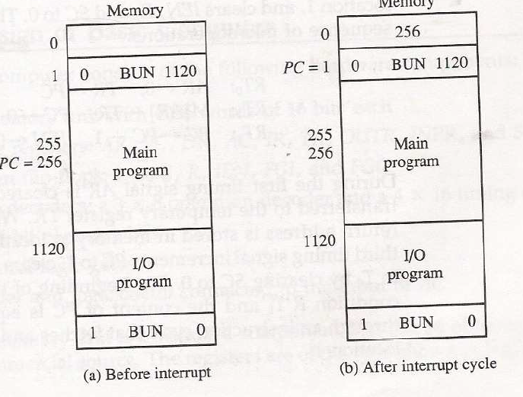

Slide 74
Service Routine
Must have instructions to perform:
  Save contents of processor registers.
  Check which flag is set.
  Service the device whose flag is set.
  Restore contents of processor registers
  Turn the interrupt facility on.
  Return to the running program.

Slide 75
Service Routine /cont.
The contents of processor registers before and after the interrupt must be the same.
Since the registers may be used by the service routine, it is necessary to save their contents at the beginning of the routine and restore them at the end.

Slide 76
Service Routine /cont.
The sequence by which flags are checked dictates the priority assigned to each device.
The device with higher priority is serviced first.
Even though two or more flags may be set at the same time, the devices are serviced on at a time.

Slide 77
Service Routine /cont.
The occurrence of an interrupt disables the facility from further interrupts.
The service routine must turn the interrupt on before the return to the running program.
The interrupt facility should not be turned on until after the return address is stored into the program counter.

Slide 78
Interrupt Service Program
Loc.
0
1
…..
100
101
102
103
104
200
ZRO,
…….
SRV,
NXT,
EXT,
SAC,
SE,
PT1,
PT2,
-
BUN SRV
…………….
CLA
ION
LDA X
ADD Y
STA Z
STA SAC
CIR
STA SE
SKI
BUN NXT
INP
OUT
STA PT1 I
ISZ PT1
SKO
BUN EXT
LDA PT2 I
OUT
ISZ PT2
LDA SE
CIL
LDA SAC
ION
BUN ZRO I
-
-
-
-
/ Return address stored here
/ Branch to service routine
/ whole program from 2 to 99
/ Portion of running program
/ Turn on interrupt facility
/ Interrupt occurs here
/ Program returns here after interrupt
/ Interrupt service routine
/ Store content of AC
/ Move E into AC(1)
/ Store content of E
/ Check input flag
/ Flag is off, check next flag
/ Flag is on, input character
/ Print character
/ Store it in input buffer
/ Increment input pointer
/ Check output flag
/ Flag is off, exit
/ Load character from output buffer
/ Output character
/ Increment output pointer
/ Restore value of AC(1)
/ Shift it to E
/ Restore content of AC
/ Turn interrupt on
/ Return to running program
/ AC is stored here
/ E is stored here
/ Pointer of input buffer
/ Pointer of output buffer

